Slide 1
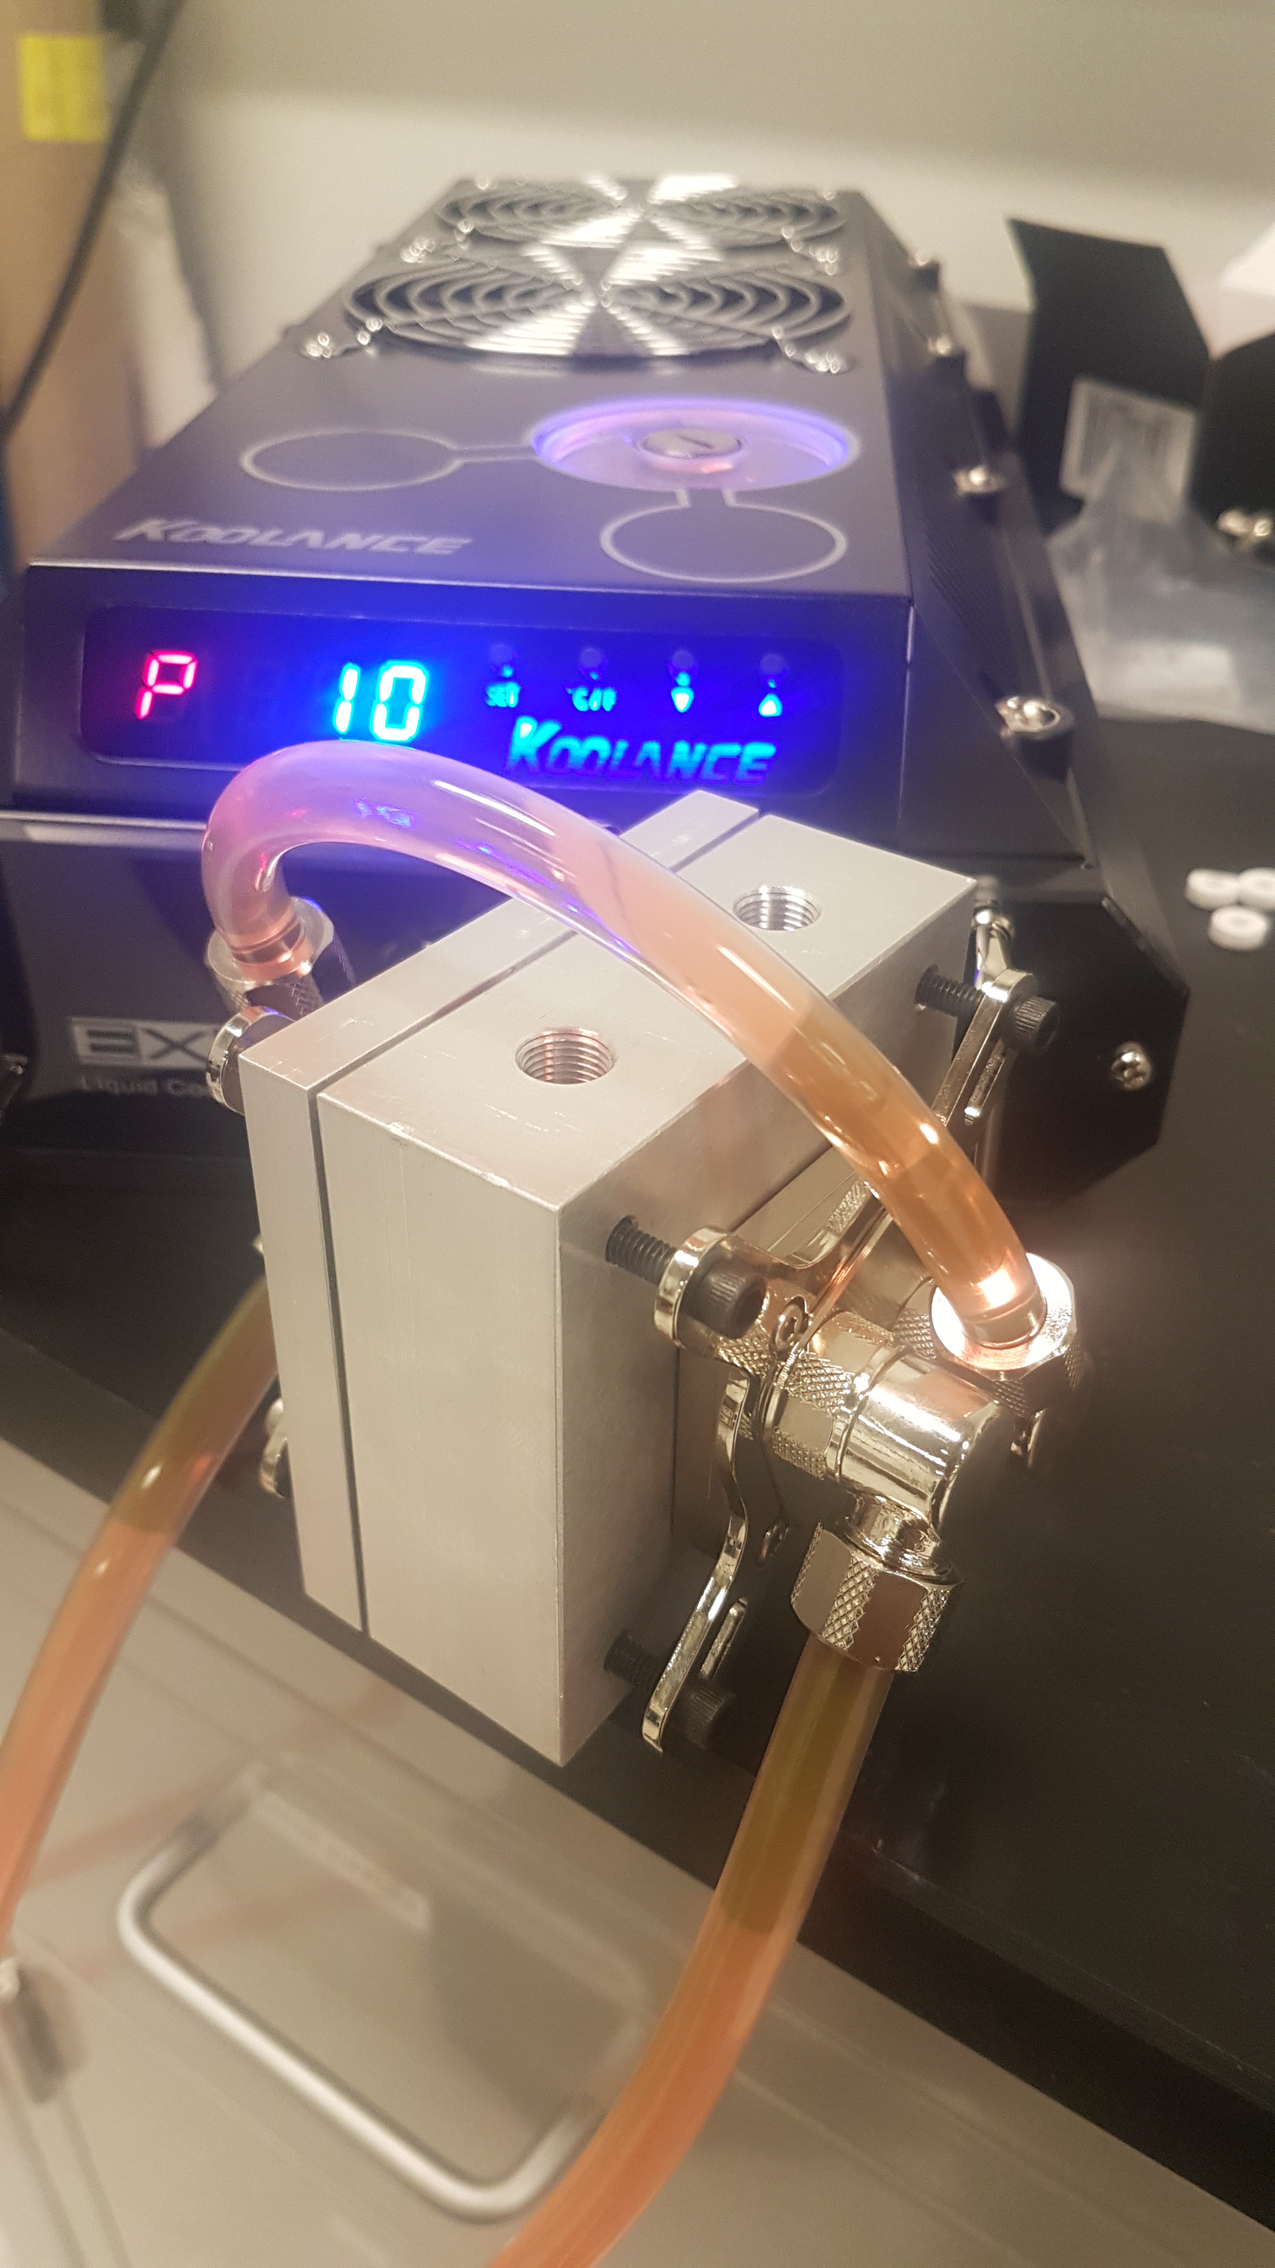
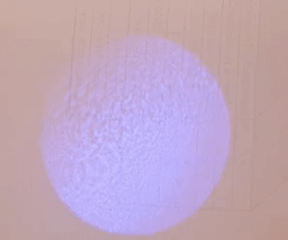

A compact injection-locked UV laser system for quantum information processing
Nikolay Videnov
Quantum Information with Trapped Ions (QITI) Group

Slide 2
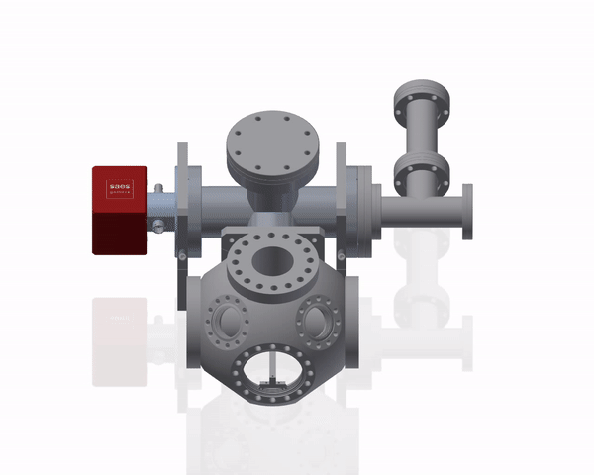
Quantum Information With Trapped Ions
New lab
Quantum simulator using trapped ions
Tackle computationally hard problems using an engineered Hamiltonian
See me after talk if you’re interested!

Slide 3
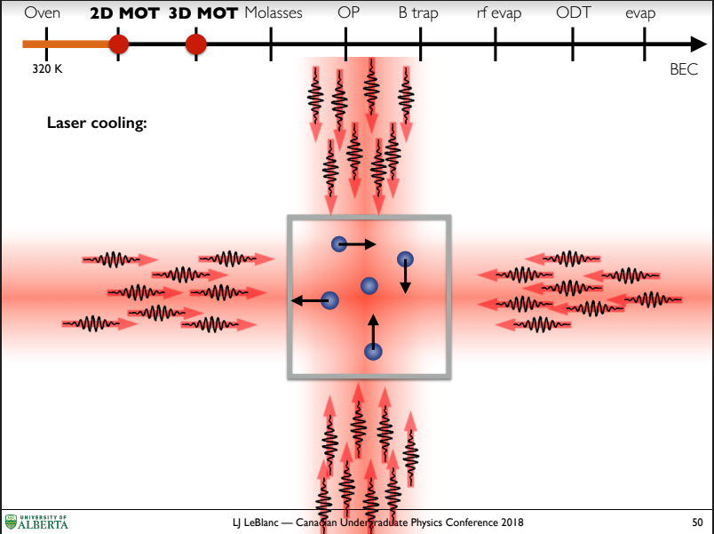
UV lasers
Uses
Laser Cooling
Optical pumping
State Detection
Getting UV light
Frequency doubling Ti:Sapph
External Cavity Diode Laser
Injection locking
Dr. Lindsay LeBlanc, keynote presentation, CUPC 2018

Slide 4
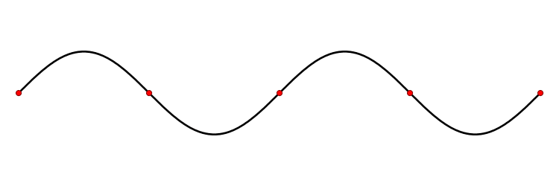
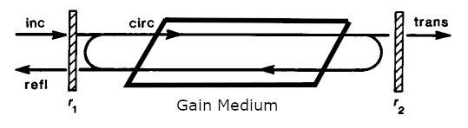

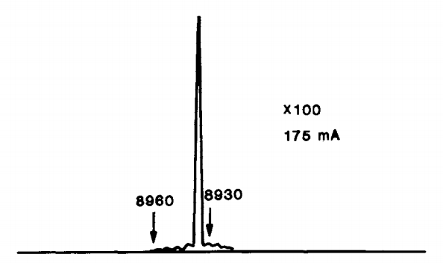
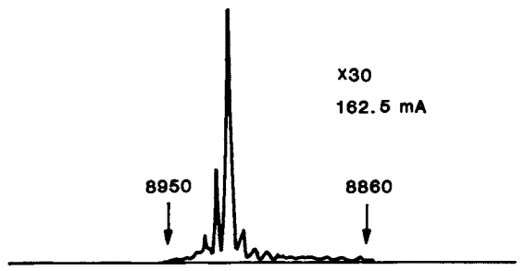
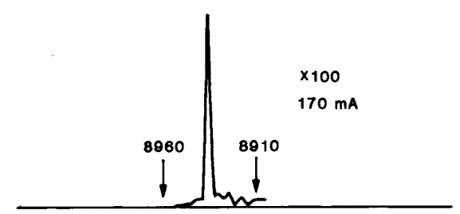
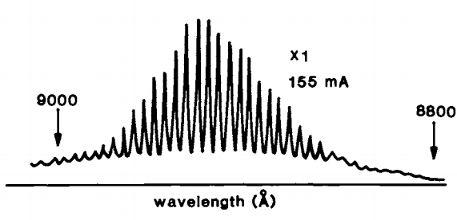
Cavity Laser
Non linear gain medium
Broadly amplifies
Finite gain at saturation
Feedback
Filters out higher order modes
Allows buildup of power in single mode

Slide 5
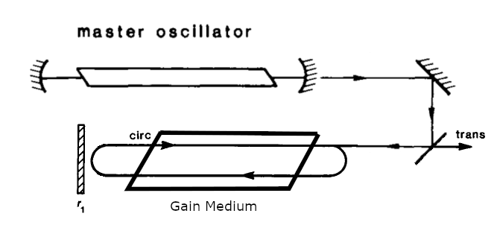
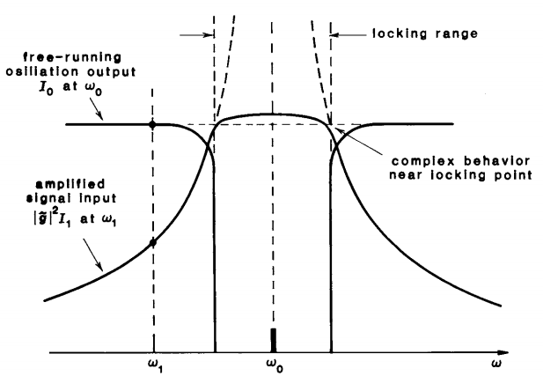
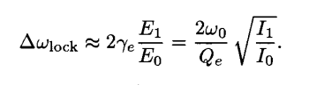
Injection Locking
Replace feedback with signal from master laser
Need a threshold amount of power to overtake the natural mode
Narrow locking range
Lasers, A E Siegman, 1986

Slide 6
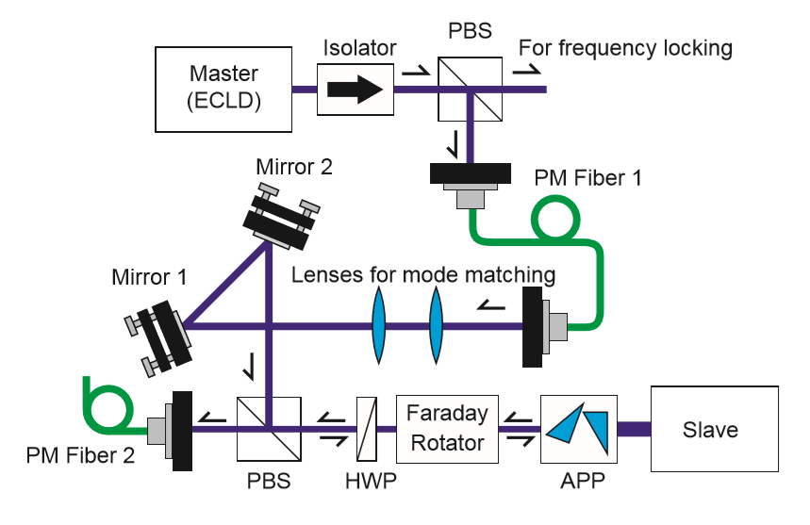
Physically realizing Injection Locking
Need ~100µW from a master laser
Faraday rotator
Slave laser diode
Generic optics
T. Hosoya et al., Review of Scientific Instruments 86, 2015

Slide 7
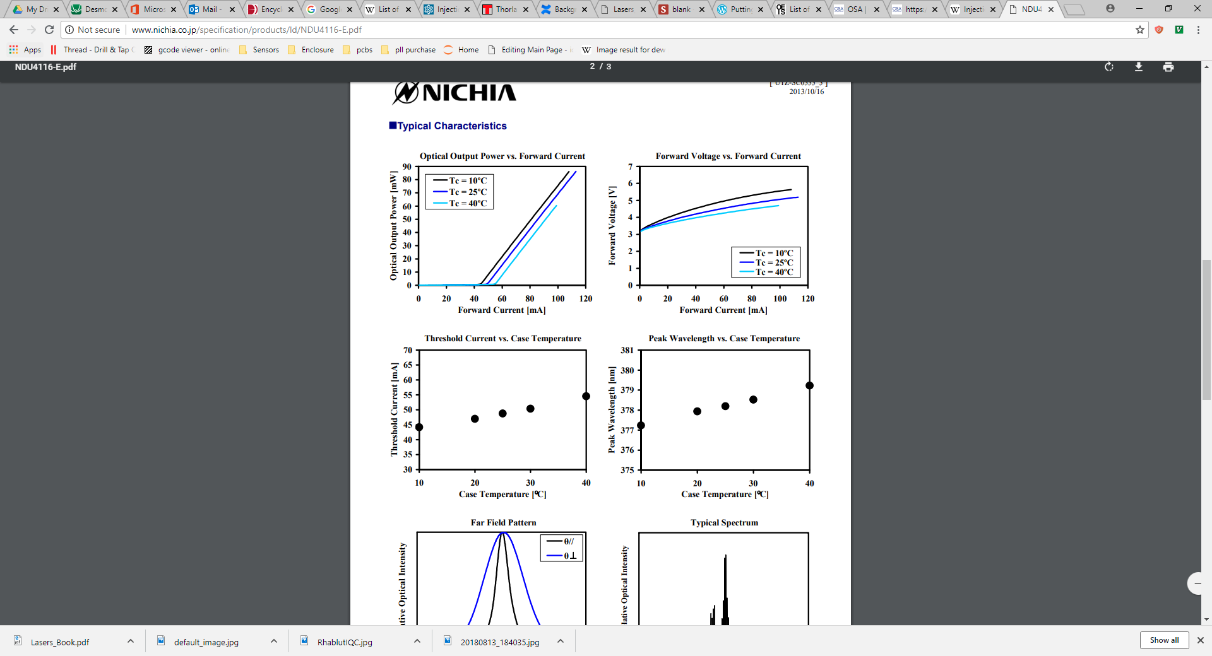
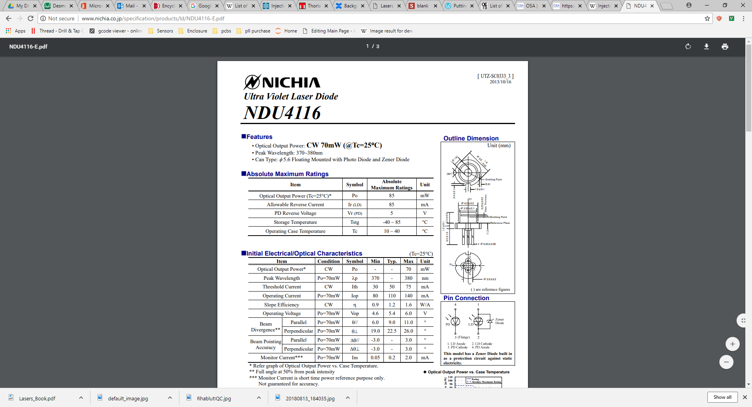
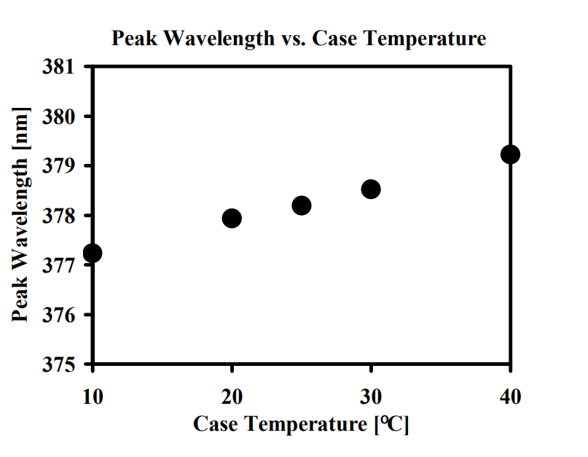
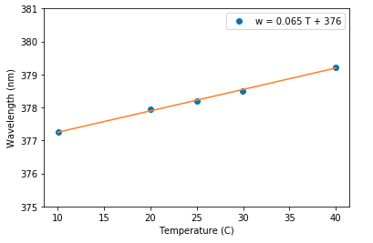
Diode Selection
Locking only happens around the free running oscillation frequency of the diode.
Need a laser diode around 369nm
The closest commercially available diode can be frequency selected to ~371nm*
Cool to 369nm?
*Nichia NDU4116 (370-380nm)

Slide 8
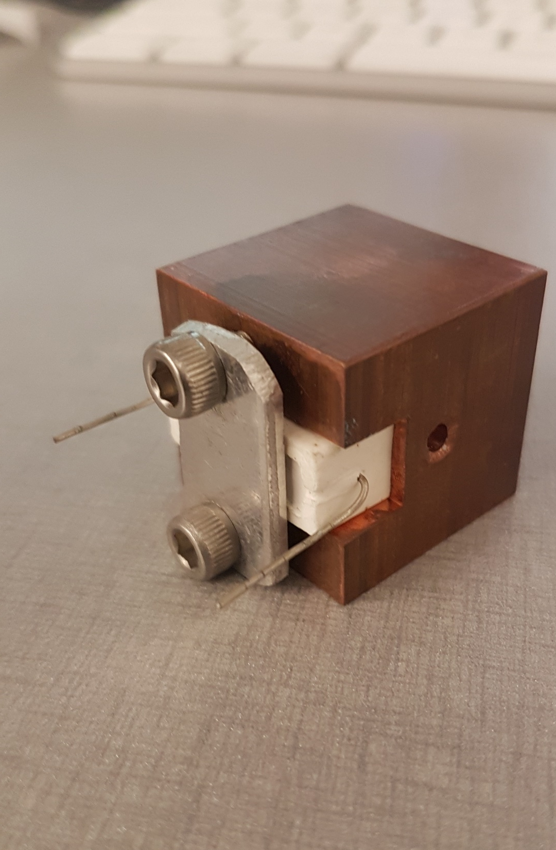
Test Fixture
40°C below lab temperature
Achievable with Thermoelectric Coolers (TEC)
A few heat load calculations later we pick a pair of TECs
Make a test block
Add a dummy load
Cool to desired temperature
Test diode holder
Dummy load

Slide 9
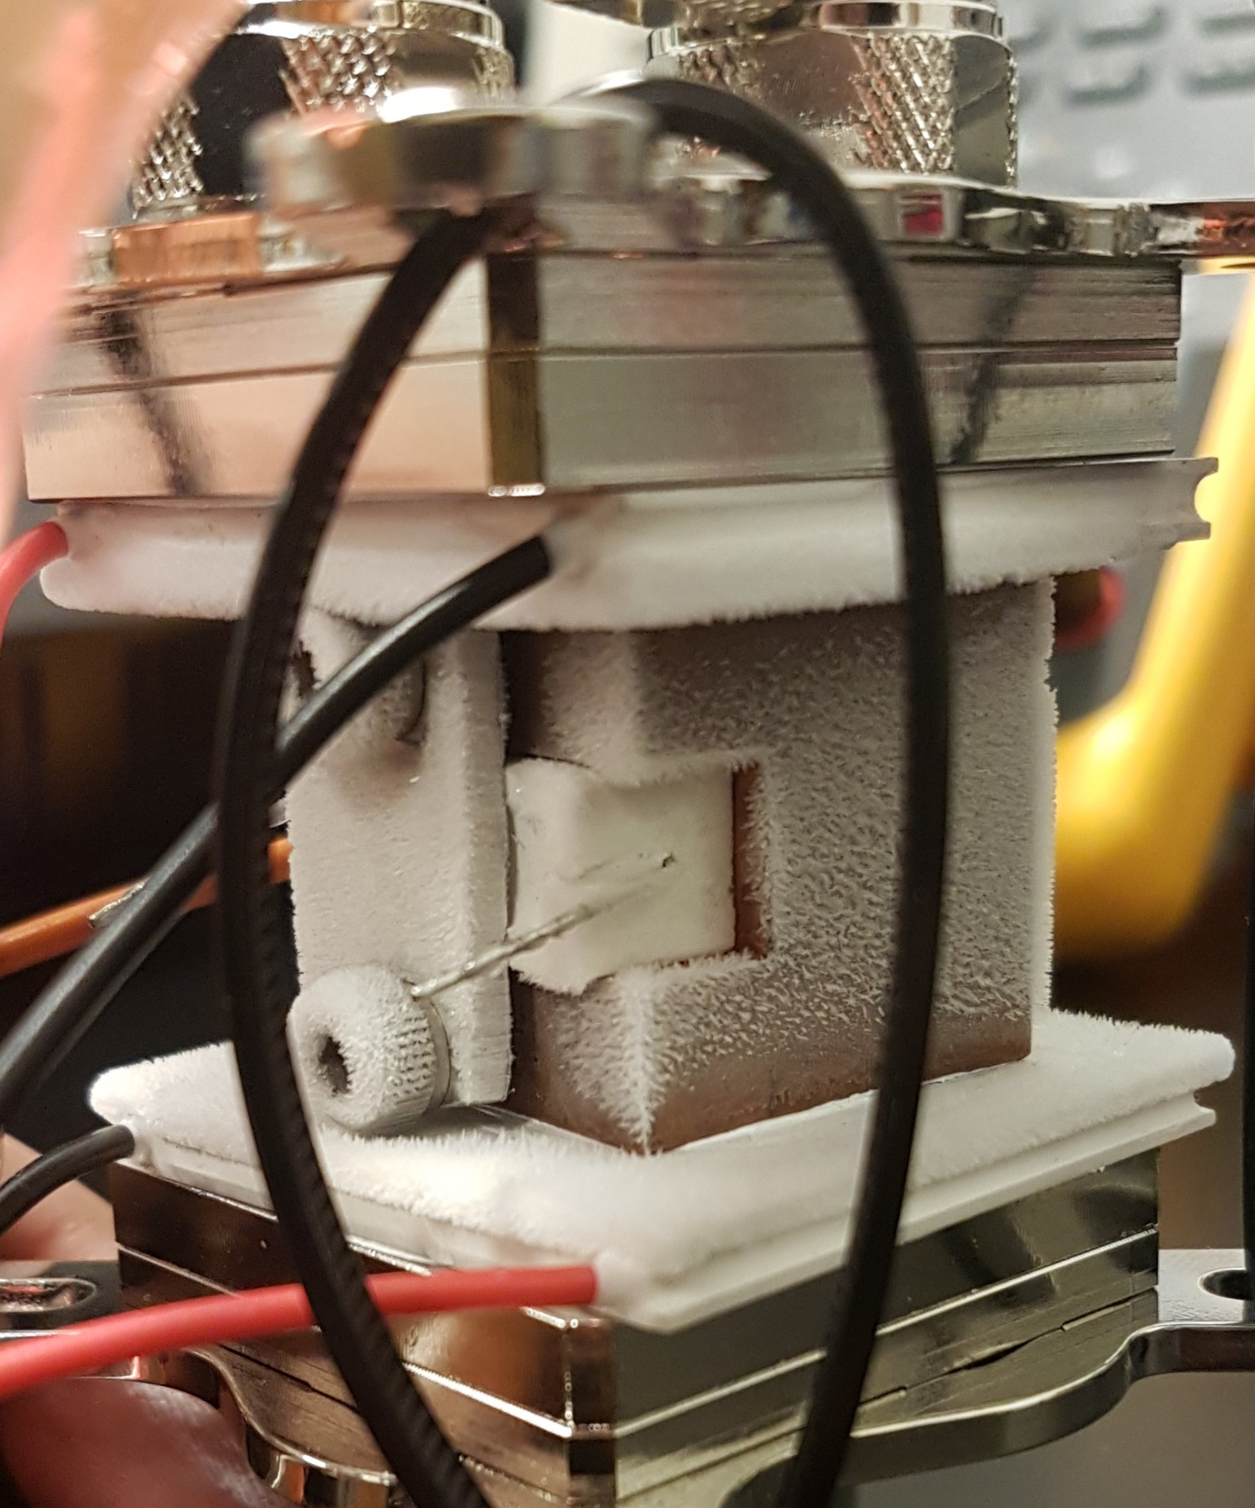
Laser Enclosure
Water Cooling
block
Cooling below the dew point causes
Condensation
frost
Pressurize with dry nitrogen
Feedthroughs
Optical
Pressurized air
electrical
TEC
Frost
Test diode holder
Dummy load
TEC
Water Cooling
block

Slide 10
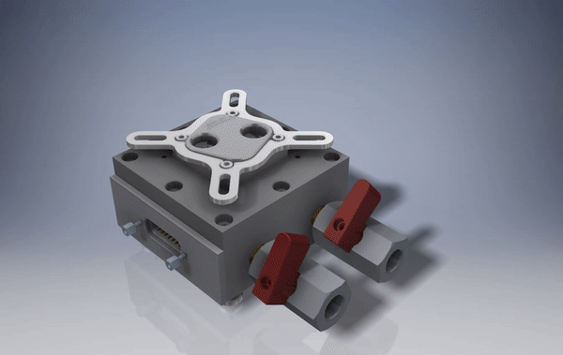

Slide 11
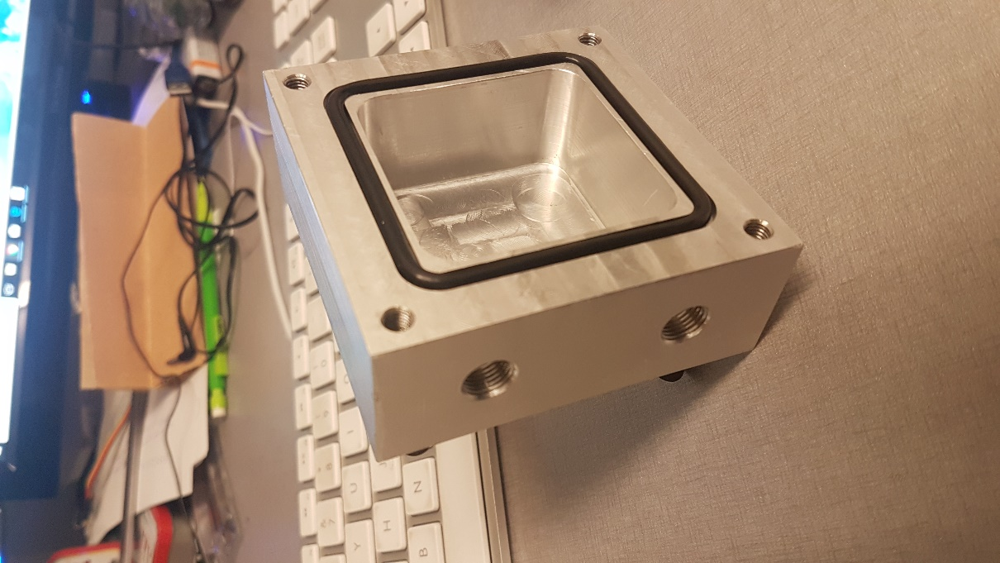
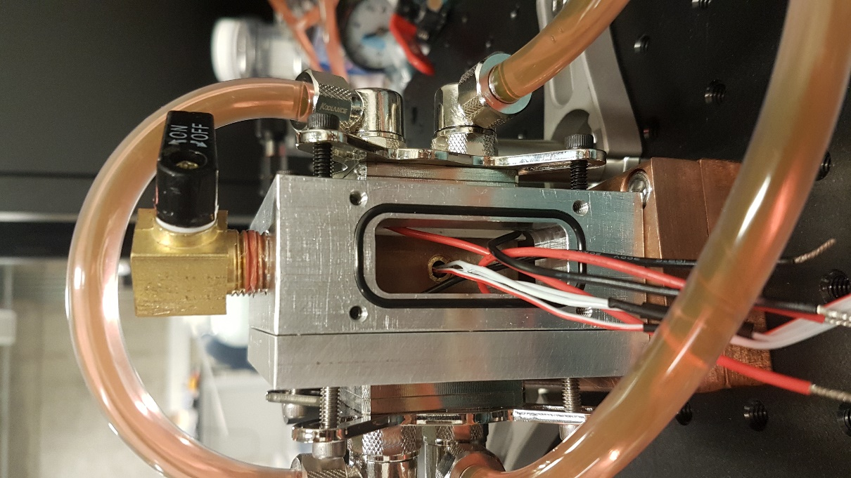
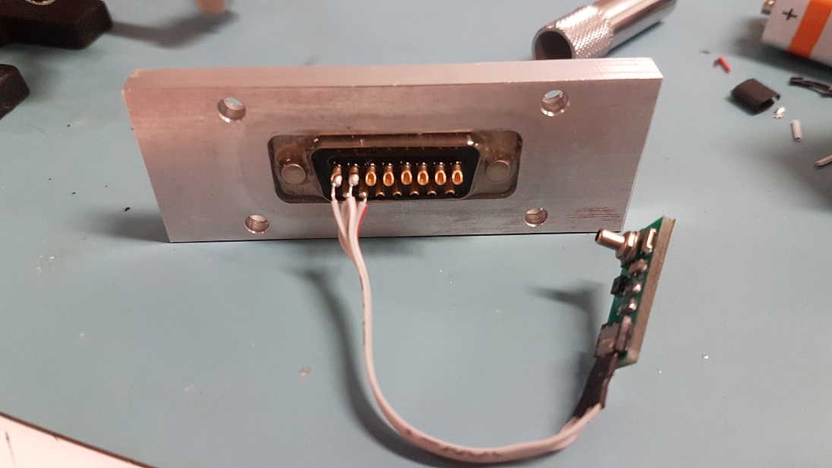
Laser Enclosure
Machined all the parts in the CAD model
Pressurize and cool
¼” NPT ball valve
Water cooling
bock
Diode Holder
O-ring
D-sub connector
Pressure Sensor

Slide 12
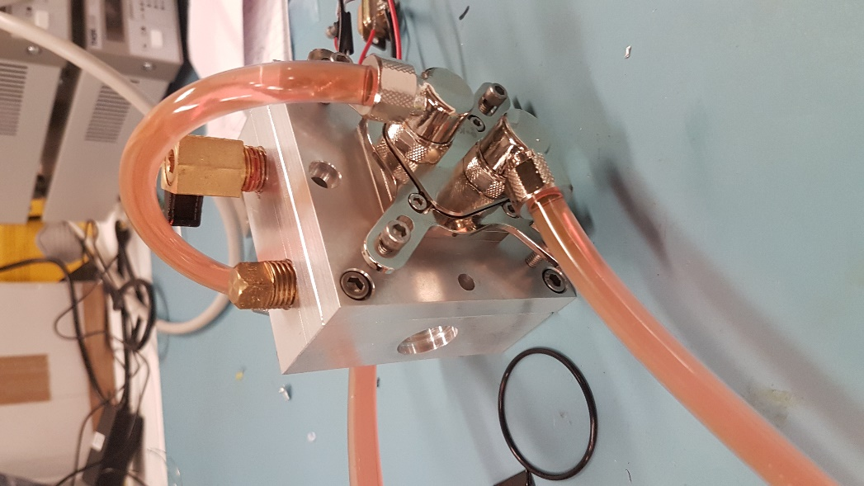
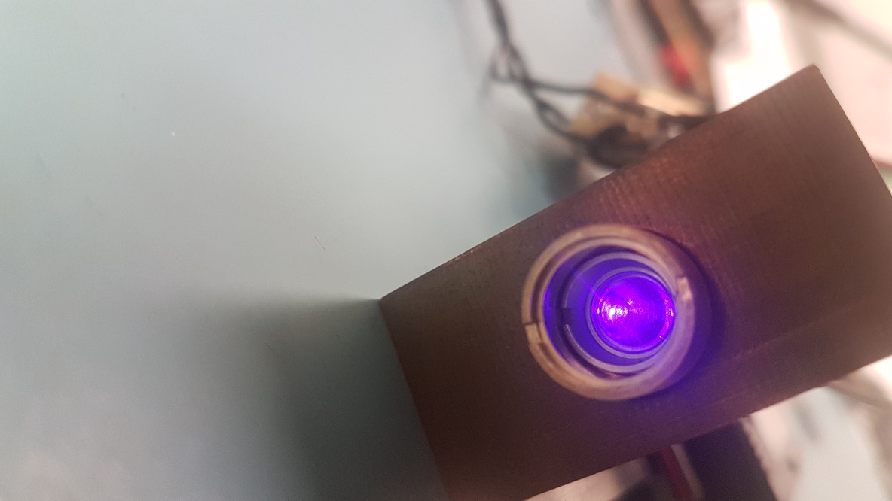
Putting it all together
Machined diode holder and enclosure
Compact collimation
Water-cooling
Constant current controller

Slide 13
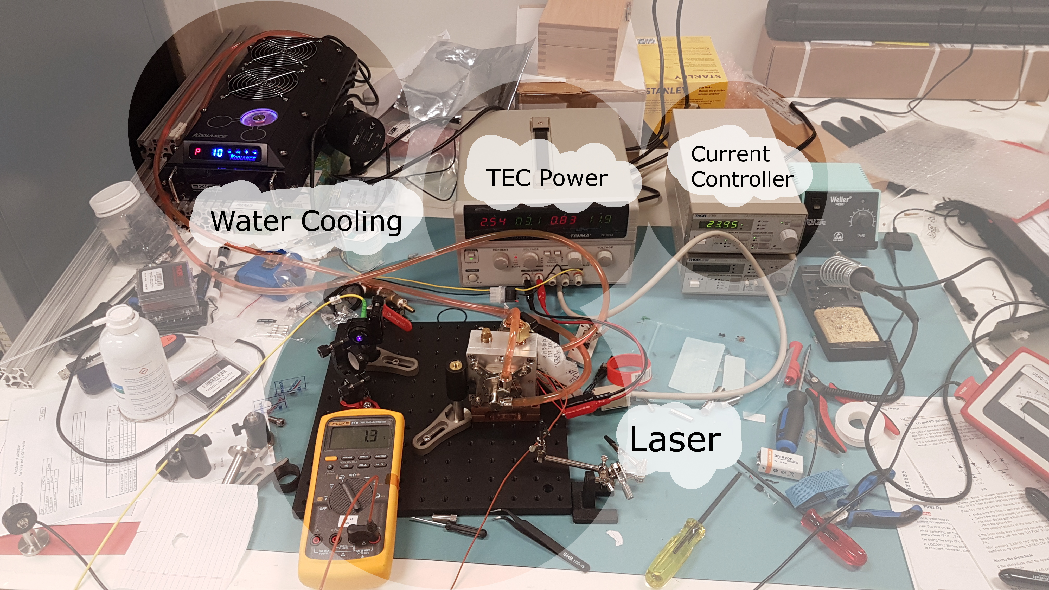
Experimental setup

Slide 14
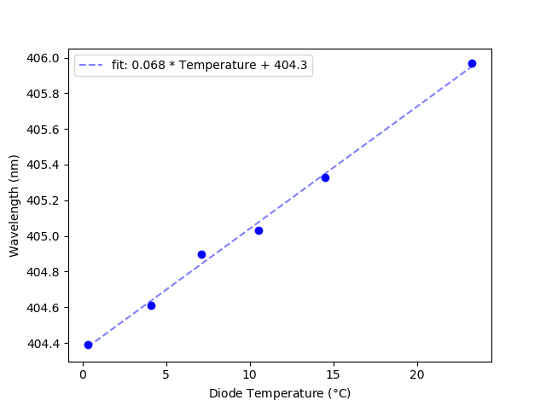
Results
Cooled diode without condensation
Achieved a 1.5nm frequency shift
Sufficient to bring diode to injection locking range
Slope matches datasheet

Slide 15
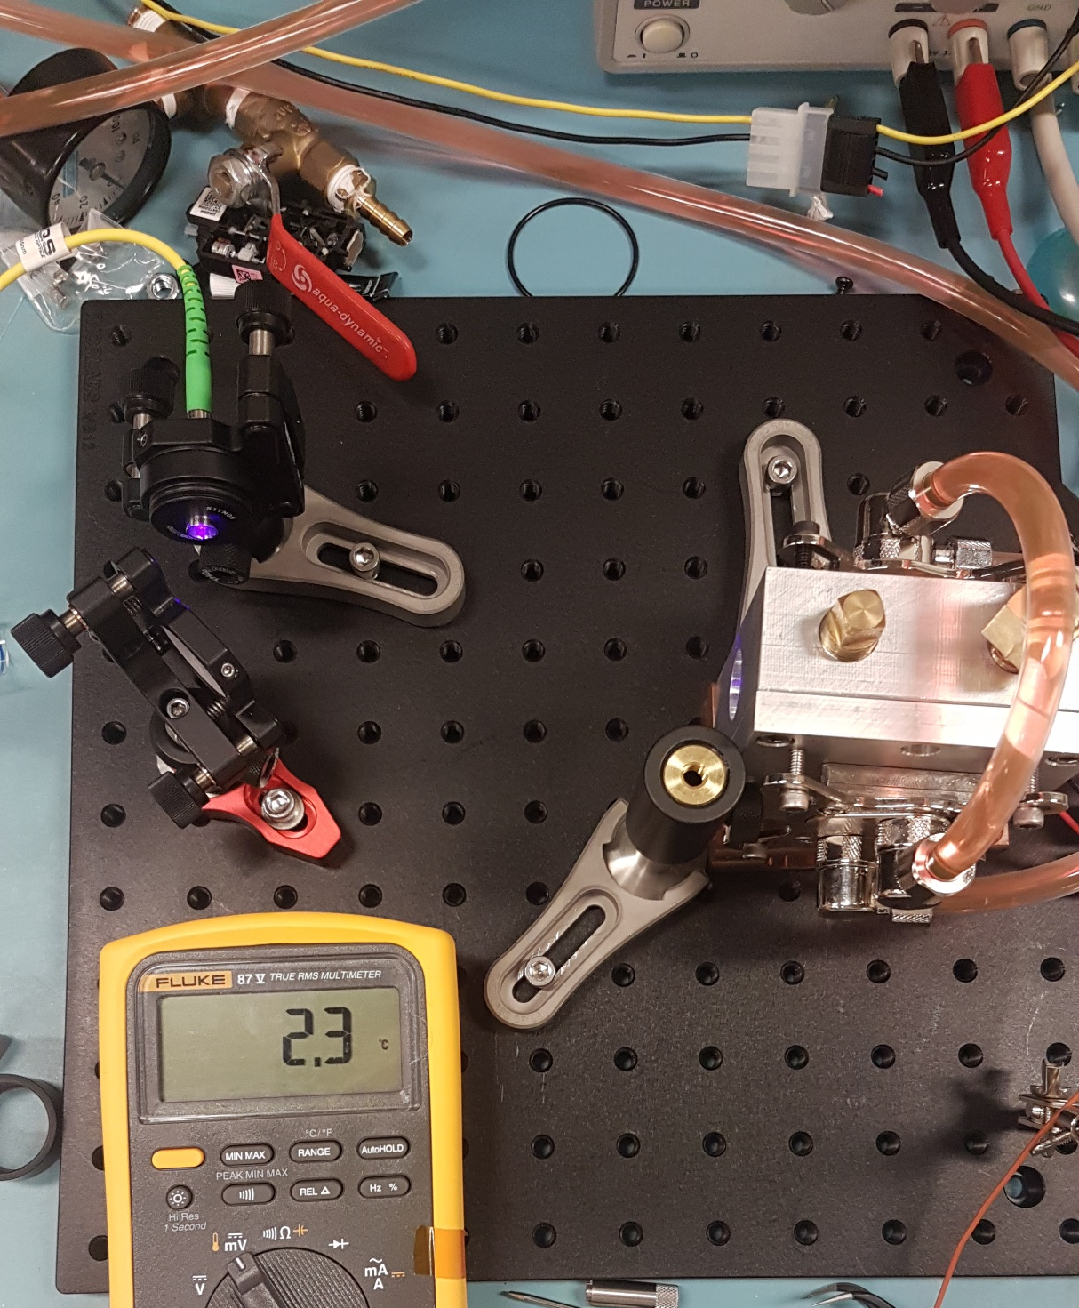
Conclusion/Outlook
Injection locking is an excellent way to amplify laser power
The challenges of diode cooling can be compactly solved with this design
Future work
Optics setup
Swapping blue ray diode to Nichia diode

Slide 16
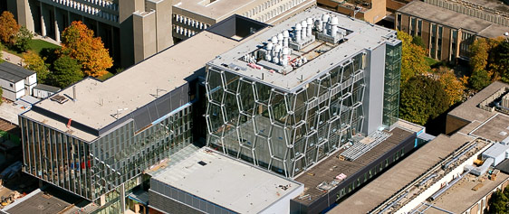







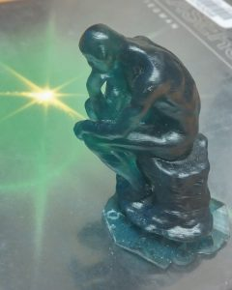
Quantum Information with Trapped Ions (QITI)
research.iqc.uwaterloo.ca/qiti/
Rajibul
Islam
Fereshteh Rajabi
Roland Hablützel
Chung-You (Gilbert) Shih
Nikhil Kotibhaskar
Sainath Motlakunta
Yi Hong
Teoh
P I
P O S T D O C S
G R A D U A T E S T U D E N T S
U N D E R G R A D S

Slide 17
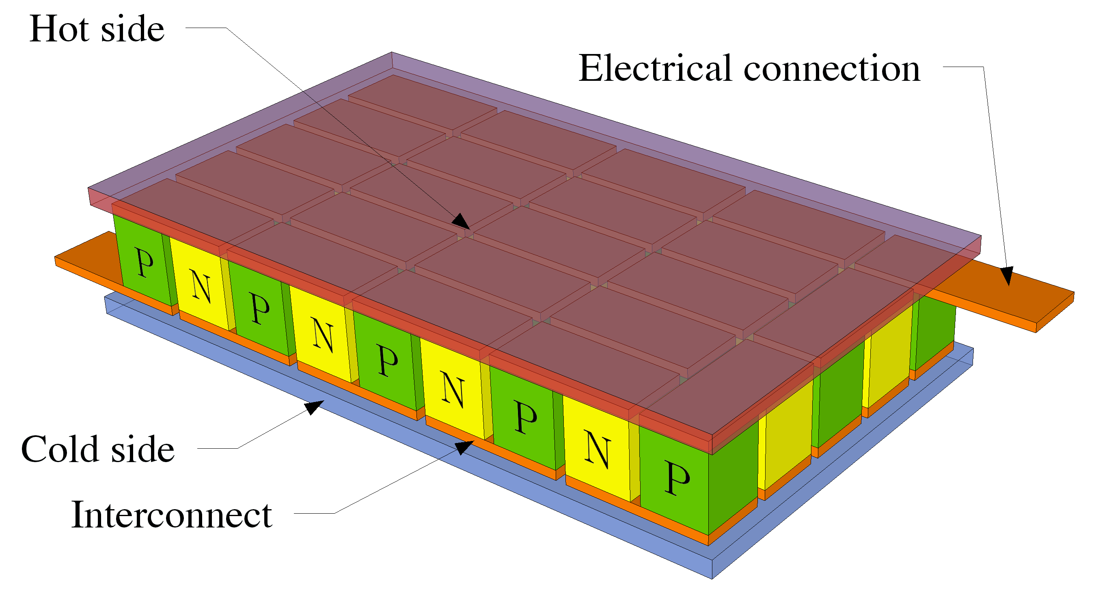
Peltier cooling (TEC)
NP junctions used to move heat from one side to other side
In a thermocouple a temperature difference at the junction of dissimilar materials produces a voltage
TEC cooling is a thermocouple in reverse

Slide 18
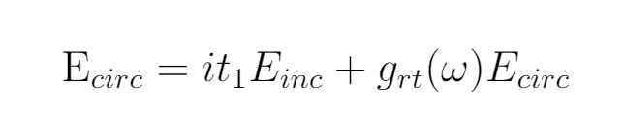
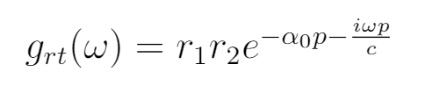
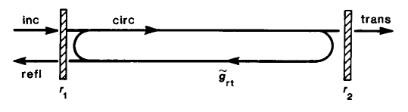
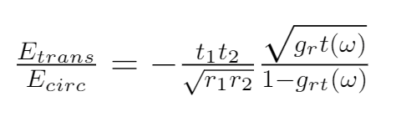
Injection Locking

Slide 19
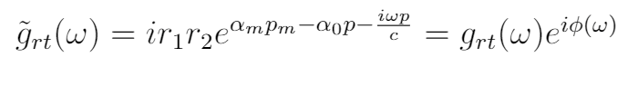
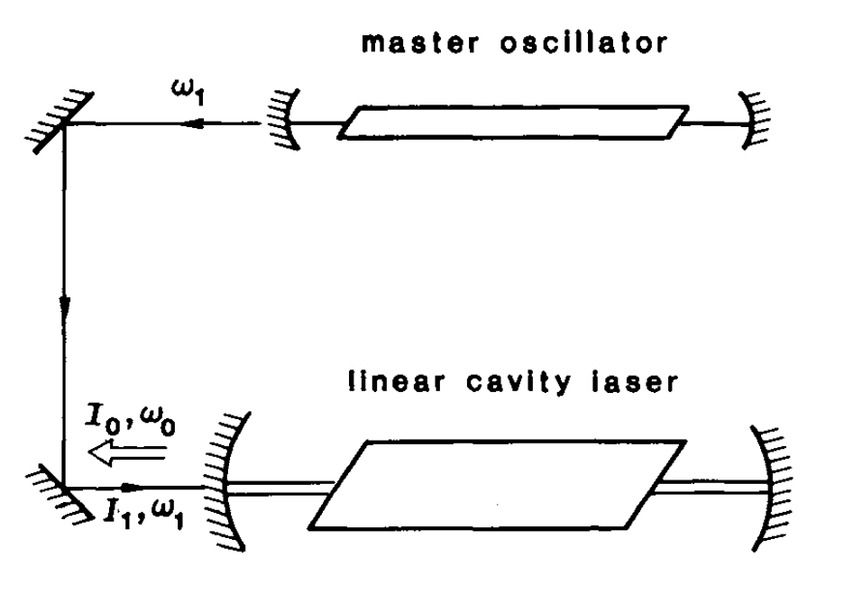
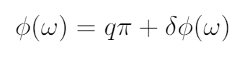
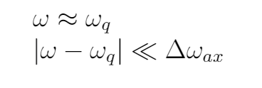
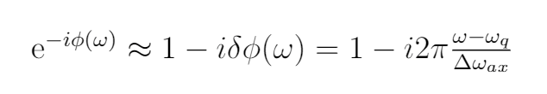

Slide 20
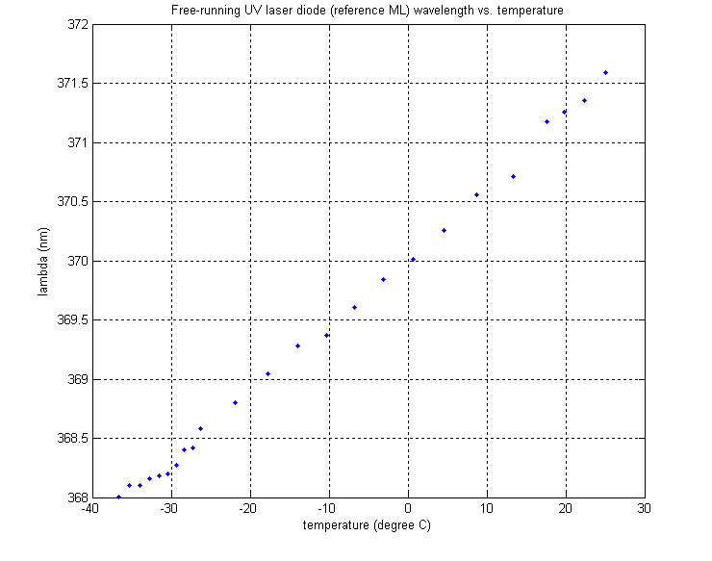

Slide 21
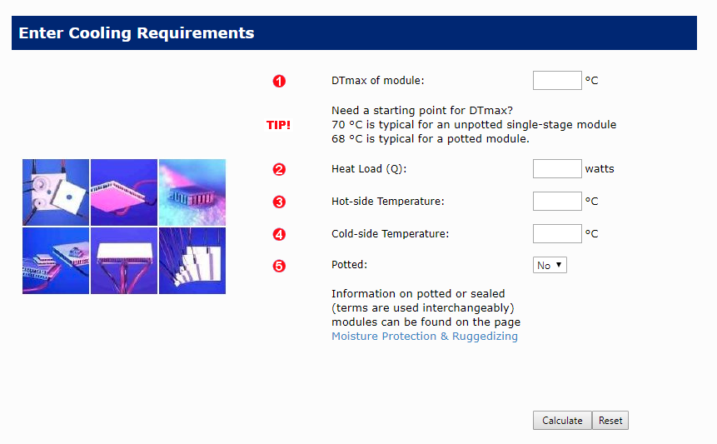
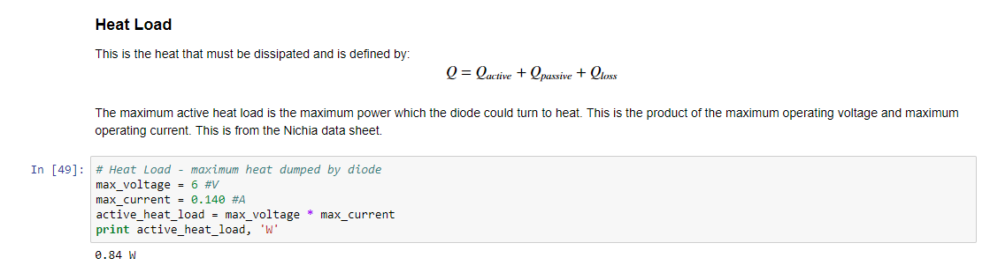
Head Load

Slide 22
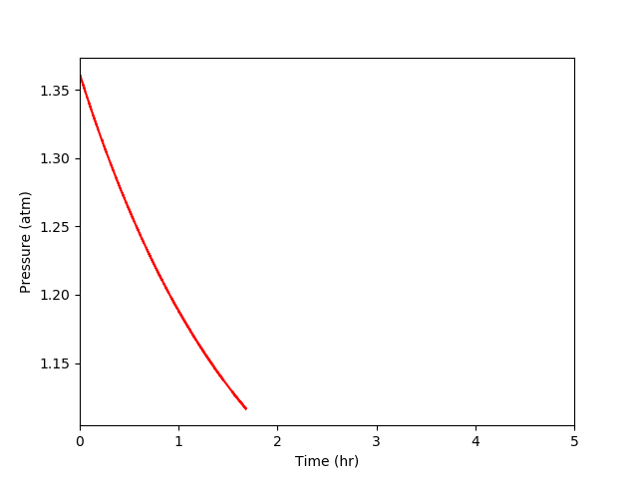
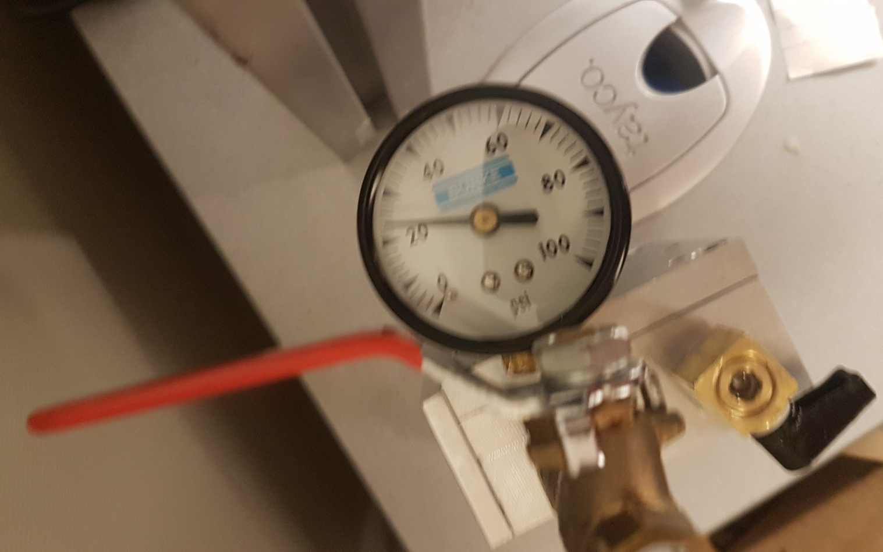
Pressure Measurement
There’s a leak!
Make a blank and seal off the electrical feedthrough

Slide 23
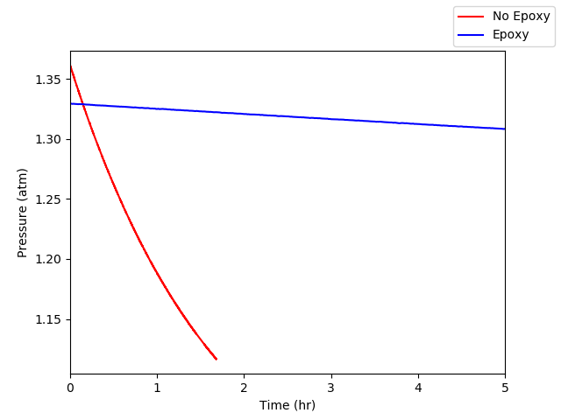
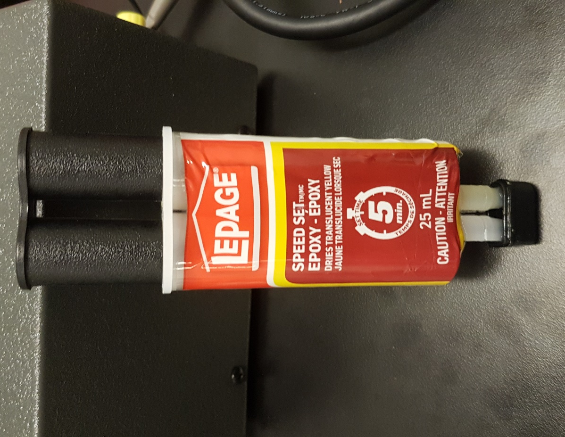
A fix all solution
5 minute epoxy
A measurable improvement!

Slide 24
